Slide 1
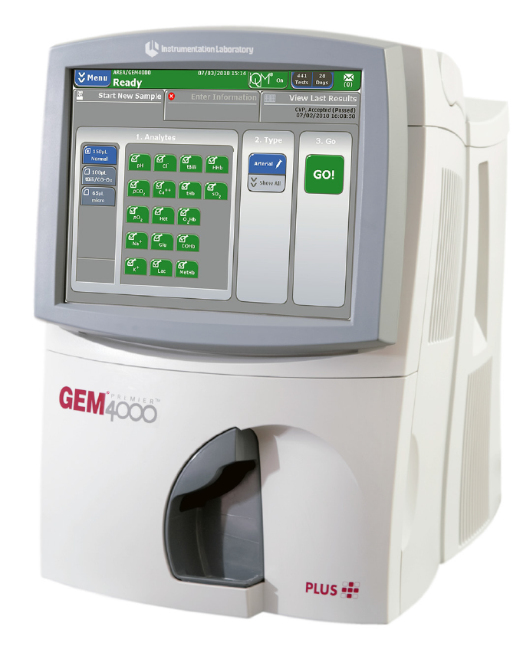
GEM Premier 4000
Blood Gas Analyzer
READ POLICY PRIOR
TO STARTING TUTORIAL

Slide 2
Qualified Personnel
Testing personnel are required to take the Initial Orientation and Training, 6 Methods of Competency Exam, and a second Competency Exam within the first year of certification for this POCT.
Competency exams are then required annually thereafter.
Clia ‘88 requires staff to have a college degree in one of these listed sciences to perform this moderately complex test. Please submit a copy of your College Degree in Chemical Science, Biological Science, Physical Science (or Nursing) to POCT Services.

Slide 3
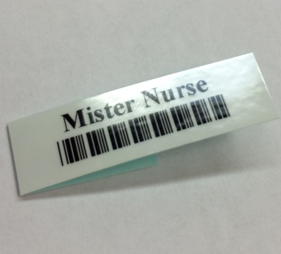
Operator Barcodes
Upon completion of the Initial Orientation and Training, 6 Methods of Competency, and Written Exam, staff will be issued a barcode ID to be able to use the GEM Premier 4000.
This barcode in embedded with unique identifiers specific to each staff member.
NEVER share your Barcode ID!

Slide 4
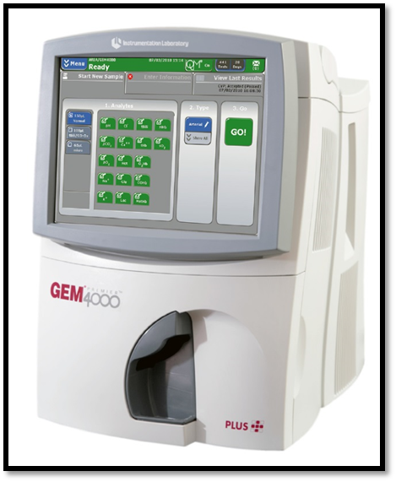
Before Testing a Patient
Orient yourself to your working area:
Locate the analyzer and cartridge.
Locate testing supplies:
Ampoule breaker
Barcode scanner
GEM CVP
Printer paper
Operator manual

Slide 5
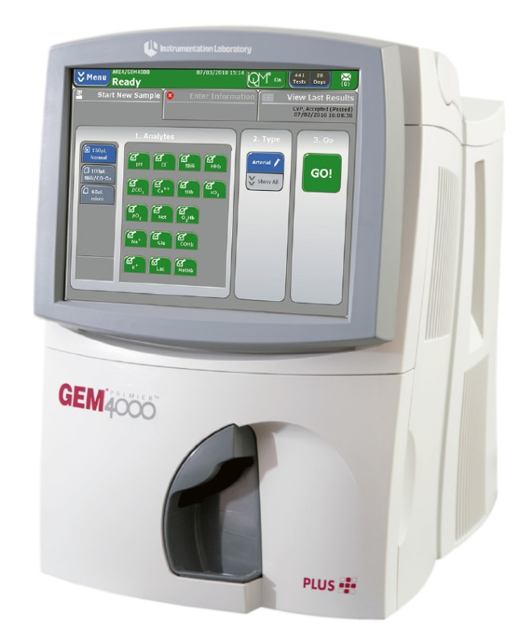
GEM Premier 4000
Using the GEM Premier 4000 is considered Moderate in complexity by the FDA.
Purpose: used to analyze whole blood samples and provide fast, accurate quantitative measurements of whole blood pH, pCO₂, pO₂, Na⁺, K⁺, ICA⁺⁺, Glucose, Lactate, Hematocrit, and CO-Oximetry.(Check your IDA page for your unit’s approved tests.)

Slide 6
The GEM Premier 4000 Consists of:
GEM Premier 4000 Analyzer
Disposable Cartridge (PAK)
Store at 15-25°C.
Stable at room temperature until the expiration date listed on the package.
Once placed in the instrument, the cartridge is stable for 30 days or when the maximum number of test is used.
Ampoule Breaker
Barcode Scanner
Operator Manual
Printer Paper

Slide 7
Quality Control
GEM CVP 1 & 2 both with CO-Ox
Used for all analytes except hematocrit.
Unopened ampules are stable until the expiration date on the label when stored at 2-8°C. If stored at room temperature (15-25°C) stability is up to 8 months from the opening date, up to but not past the expiration date on the label.
DO NOT FREEZE.

Slide 8
Quality Control
GEM CVP 3 & 4
Used for hematocrit.
Unopened ampules are stable until the expiration date on the label when stored at room temperature (15-25°C).
DO NOT FREEZE.

Slide 9
Quality Control
Intelligent Quality Control Management (iQM)
Monitors the performance of the system in real-time.
Identifies the potential failure patterns.
Automatically performs corrective actions.
Automatically documents the failure and the corrective action taken.

Slide 10
Quality Control
Calibration Valuation Product (CVP)
Intended for the verification of the integrity of the new cartridge every time it is replaced. All levels of CVP must pass for each analyte before the instrument can report patient results.
Patient Comparisons
Patient samples are compared against the reference instrument (GEM1) in the Clinical Lab.
Each department should bring and hand a patient sample in Hematology. This is done once a month by Super Users.

Slide 11
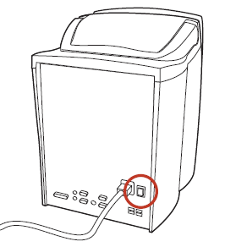
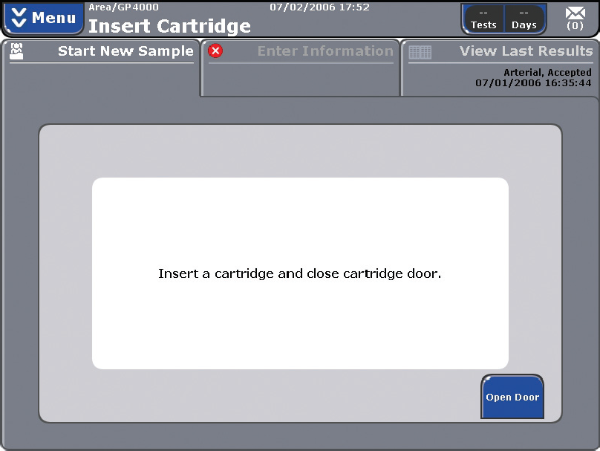
Cartridge Insertion and Warm-Up
If the analyzer is OFF, press the power switch to turn it ON.
NOTE: the analyzer should remain powered on unless it is being transported to another source without an uninterruptible power source (UPS).
Press “Open Door” on the touch screen and manually move the door all the way to the left.

Slide 12
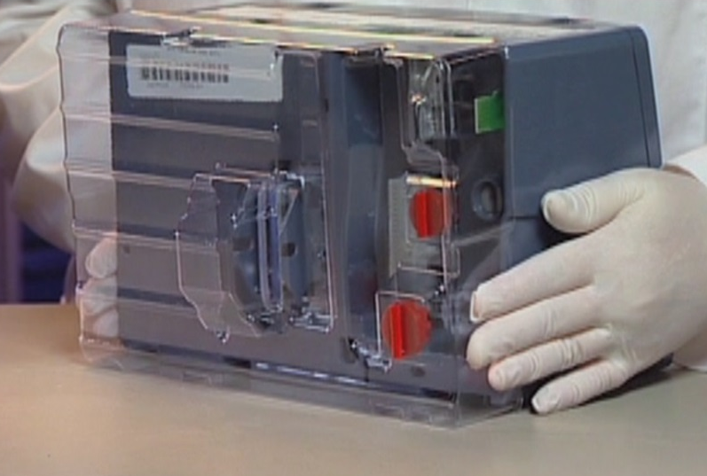
Cartridge Insertion and Warm-Up
Unpack the cartridge from its protective wrapper.
Remove the plastic cover from the pump winding area.
Check the inside of the protective wrapper to be sure that it is dry.
CAUTION: Do not use expired or leaking cartridges. If there is any moisture inside the foil bag, DO NOT USE. The cartridge must be at room temperature (15-25°C).

Slide 13
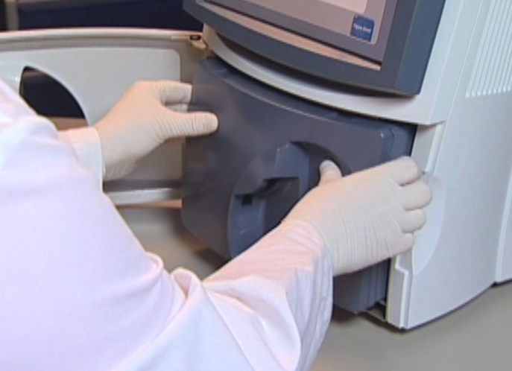
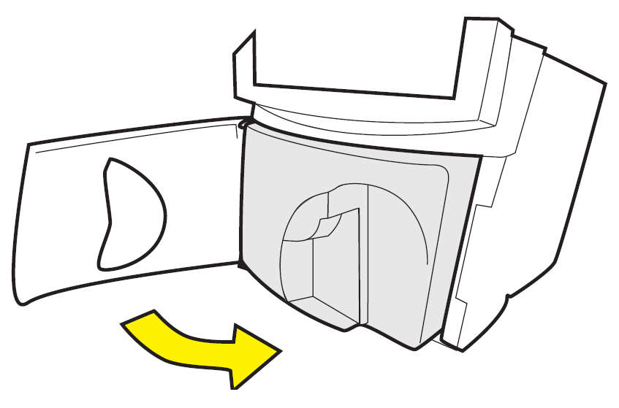
Cartridge Insertion and Warm-Up
Position the cartridge with the gray sampling area facing forward.
Push the cartridge in until you feel resistance.
Guide the analyzer door to the right to close it.
Cartridge warm-up requires 40 minutes.

Slide 14
CVP Sampling
It is necessary to perform CVP testing only when inserting a new cartridge.
Patient results for an analyte cannot be reported until all levels of CVP pass for that analyte.
Complete testing will require approximately 12 minutes. During this time, the analyzer will be unavailable for sampling.

Slide 15
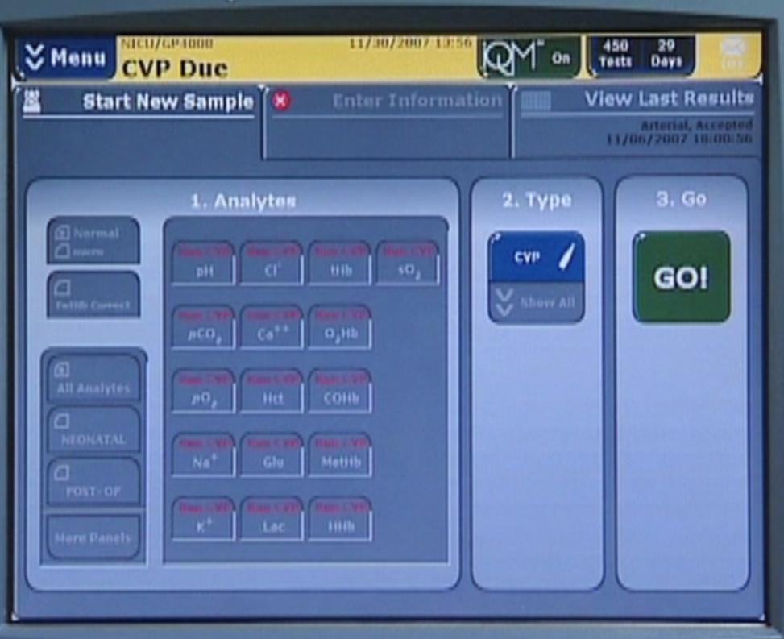
CVP Sampling
The analyzer will inform you that CVP testing is due via the Status Bar along the top of the Start New Sample Tab, which will be highlighted in yellow with the words, “CVP Due” prominently displayed.

Slide 16
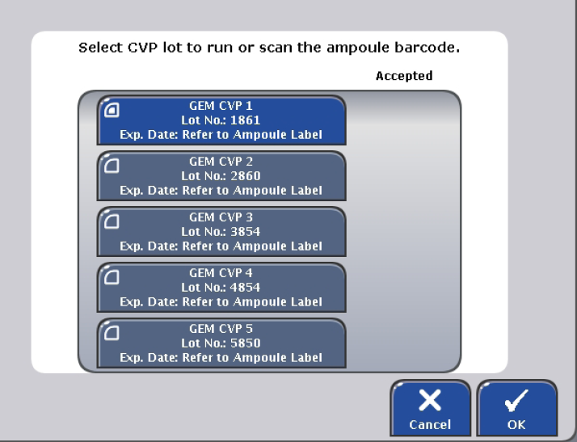
CVP Sampling
Press GO! To begin sampling.
Select an ampule from the choices on the screen

Slide 17
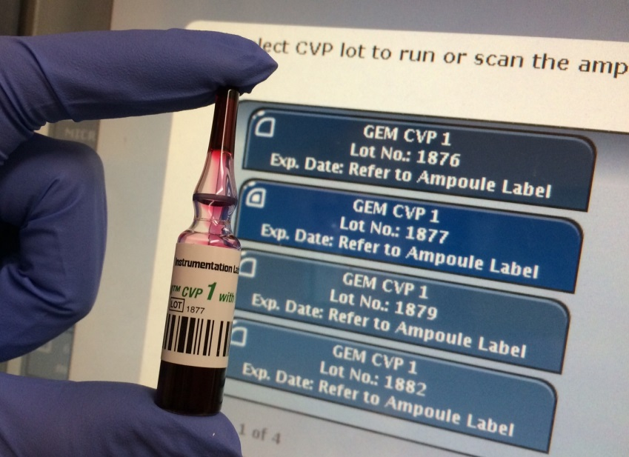
CVP Sampling
Ensure that the lot number and level match what is chosen on screen.
Immediately prior to use, hold the ampules by the top, above the break line, and shake vigorously for approximately 10 seconds.

Slide 18
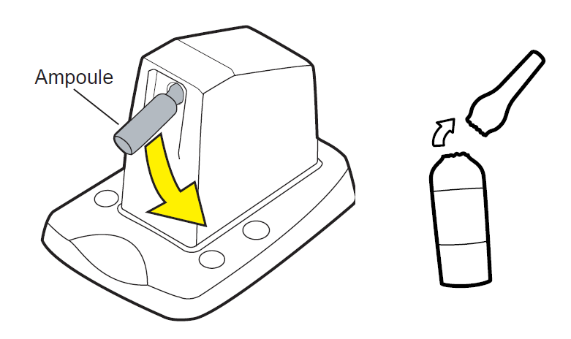
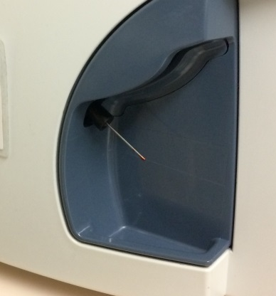
CVP Sampling
Press OK to begin testing.
Gently tap the ampules so the liquid settles back to the bottom.
Carefully snap open the ampules using the ampule breaker.
NOTE: aspirate samples immediately after opening.
The sample probe will emerge from the gray sampling area in front of the analyzer. Hold the ampule so the end of the sample probe does not touch the bottom.

Slide 19
CVP Sampling
Press OK to begin aspiration. Remove the ampules immediately upon hearing the audio prompt alerting the operator when the instrument has aspirated enough of the CVP sampling solution.
Analyte buttons will continue to display Run CVP until all CVP testing required for that analyte is complete.

Slide 20
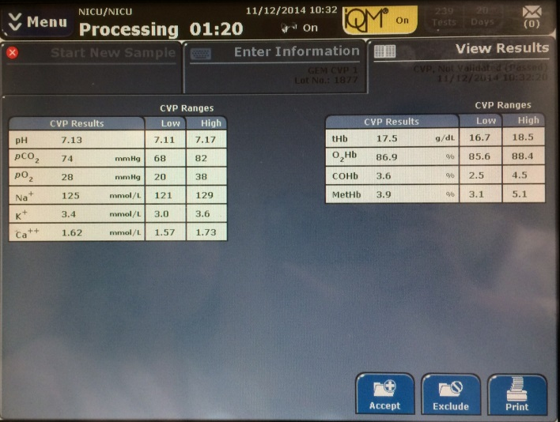
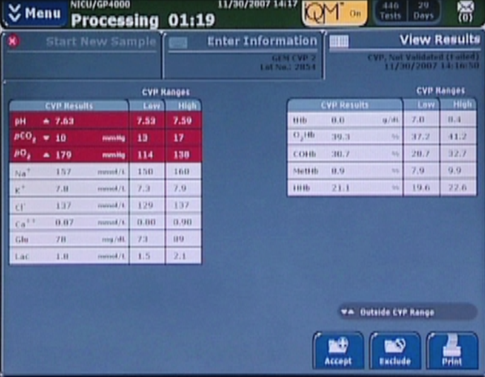
CVP Sampling
Once testing is complete, all results within range will be indicated in GREEN text with a white background; out-of-range results will be indicated in WHITE text on a red background.
If all results are within range, press Accept.
All results within range
Results out-of-range
Accept button

Slide 21
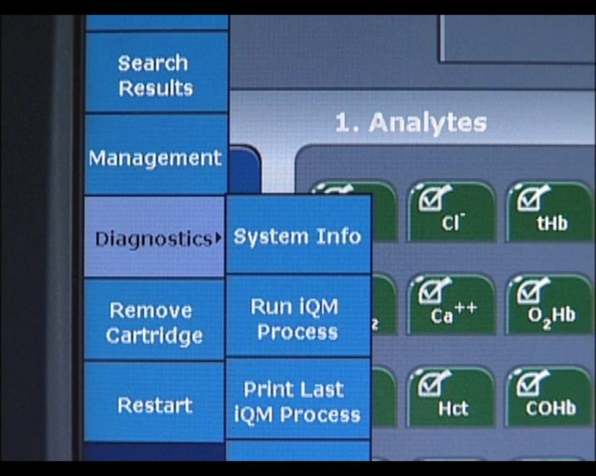
CVP Sampling
If the results are out-of-range, repeat CVP using a new vial. The operator is then prompted to run iQM process prior to repeating the analysis with a new vial.
To initiate the iQM process:
Select Menu> Diagnostics> Run iQM Process
Run a new vial after completion of the iQM process

Slide 22
CVP Sampling
If the analytes that failed the acceptable range the first time, fail again, DO NOT USE THE CARTRIDGE.
If the original analytes that failed, pass, but analytes that passed the first time, fail, run a third new vial. NOTE: Do not run more than 3 times. Multiple repeats of CVP 1 or CVP 2 can lead to the deterioration of the sensors.
If all results are within range, press Accept.

Slide 23
CVP Sampling
If you are not able to use a cartridge, contact IL Technical Support at 1.800.678.0710. Also, contact the POCT Team.
When the CVP testing is complete and all analytes are within range, you will see the Start New Sample tab. When all the analyte selection buttons show GREEN and the upper status bar indicates READY, patient sampling can begin.
Upper Status Bar

Slide 24
Patient Sampling
Universal precautions should be observed through all phases of the testing procedure
Use syringes in ABG kit or 1cc tuberculin syringe only. DO NOT USE SYRINGES WITH NEEDLES ATTACHED.
Explain procedure to patient and/or family.

Slide 25
Patient Sampling
Stability and Storage of Specimens
Samples have different storage condition requirements, depending on the container type:
Plastic syringe samples
They should be kept at room temperature as long as the blood is analyzed in 15 minutes or less. Samples should be analyzed immediately
Capillary Samples
Analyze within 5 minutes. If delay is greater than 5 minutes the sample should be recollected.
Minimum Volume: 150 μL

Slide 26
Patient Sampling
Stability and Storage of Specimens
Criteria for unacceptable specimens – REDRAW if:
Any degree of clotting
Insufficient quantity
Incorrectly drawn specimens
Incorrectly handled specimens prior to sampling
Incorrect anticoagulant

Slide 27
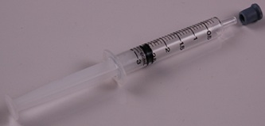
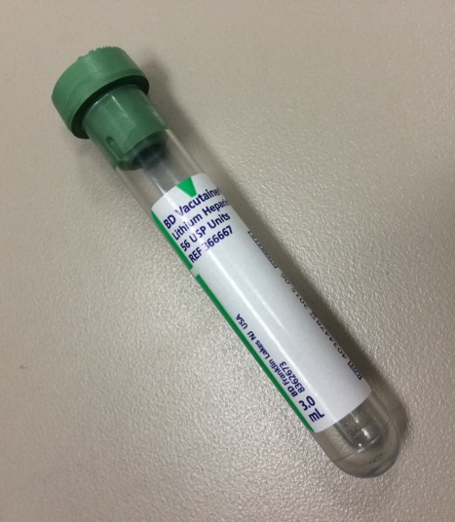
Patient Sampling
Samples must be labeled with the patient’s identification (at least 2 patient identifiers are needed – full name and medical record number or date of birth).
Types of patient samples accepted by the GEM premier 4000 includes: Arterial, Venous, Capillary, and Cord (both Cord Arterial and Cord Venous).
Notes:
CHANGE THE PICTURE…

Slide 28
Patient Sampling
Syringe and Capillary Samples
Select a pre-defined analyte combination panel
Micro sampling (65μL) is available only with capillary tubes.
A check and a dark green tab indicate that the analyte is operational.
Menu Options for NICU
Menu Options for OR/ED
Menu Options for ICU

Slide 29
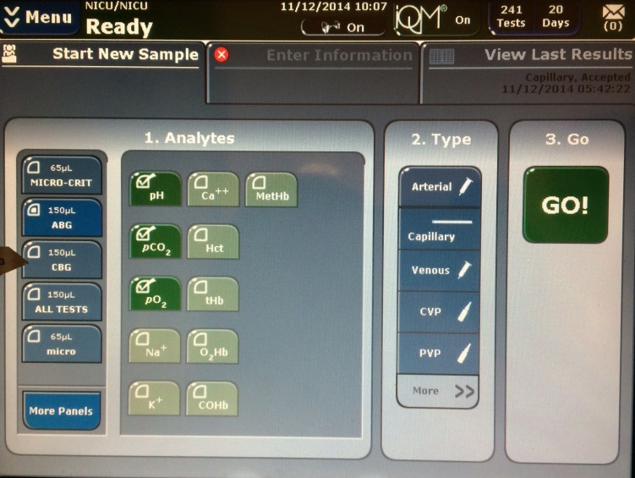
Patient Sampling
Syringe and Capillary Samples
Select the sample type by using the drop-down menu under “Type”. Choose if the sample is arterial, venous, capillary, cord or CVP.
Press “GO”.
The next screen appears which requires the operator to “enter operator password”. Scan your barcode and press enter.
Do not share your barcode with anyone. Sharing barcode IDs is prohibited.
Go Button
Type Drop-Down Menu

Slide 30
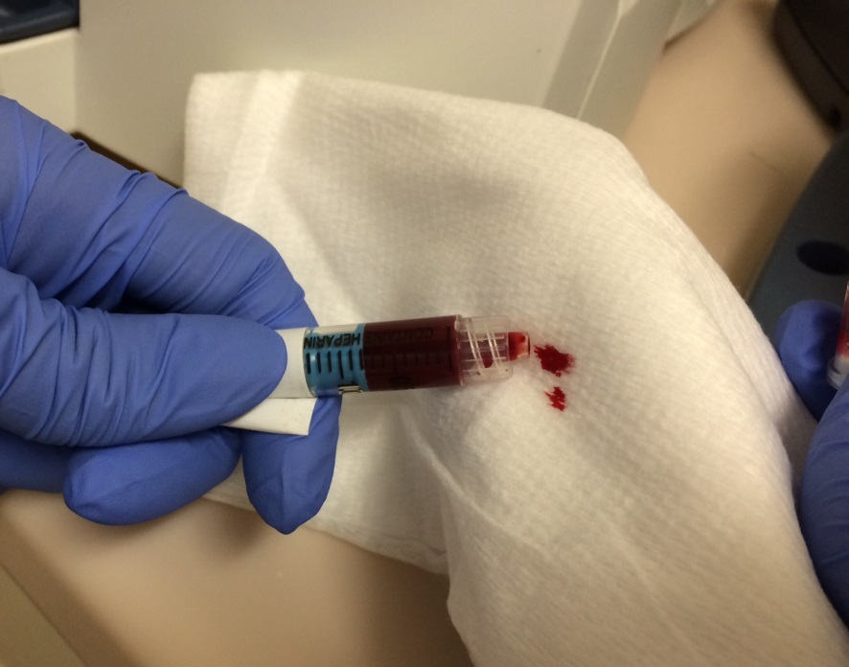
Patient Sampling
For syringe samples, (RIGHT BEFORE SAMPLING) expel all air and mix the sample thoroughly by inverting at least 3 to 5 times and roll between palms for at least 15 seconds.
Push out a few drops of the sample onto a gauze pad to ensure there is no clot on the syringe.

Slide 31
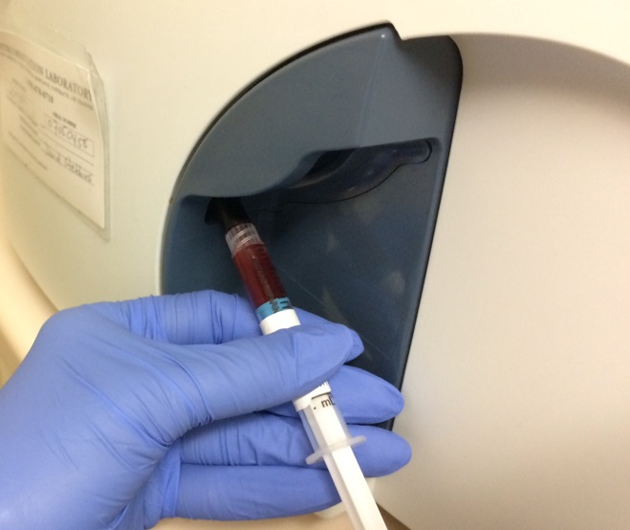
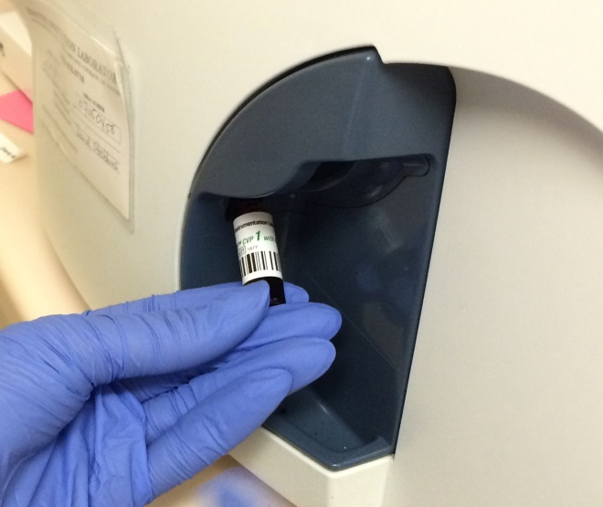
Patient Sampling
For syringe or ampule sampling:
Present the sample by placing it over the end of the sampler.
The sampler should be inserted far enough into the container to allow aspiration but not so far that the sample touches the bottom of the device.
The GEM prompts “Present Sample Now”. Press OK to begin aspiration.

Slide 32
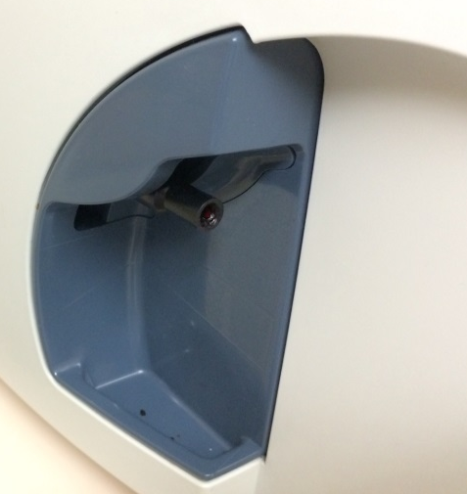
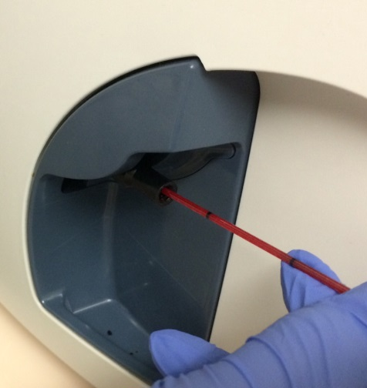
Patient Sampling
For capillary tube sampling:
the luer tip will present just below the home area (the sampler will not extend).
Tilt the tube slightly until the blood is flush with the end of the capillary tube. Place one end of the capillary tube in the luer tip.
If there is blood or debris on the outside of the capillary tube, wipe the end prior to placing it in the sampler.
Do not use excessive force. Hold the exposed end of the tube.

Slide 33
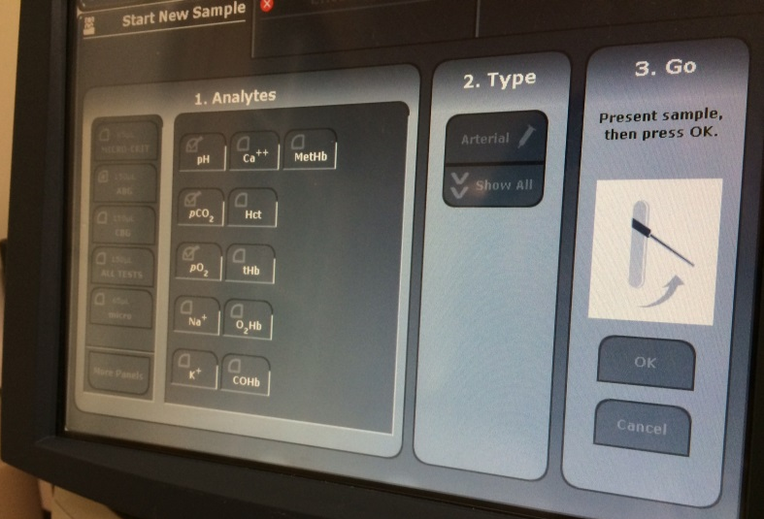
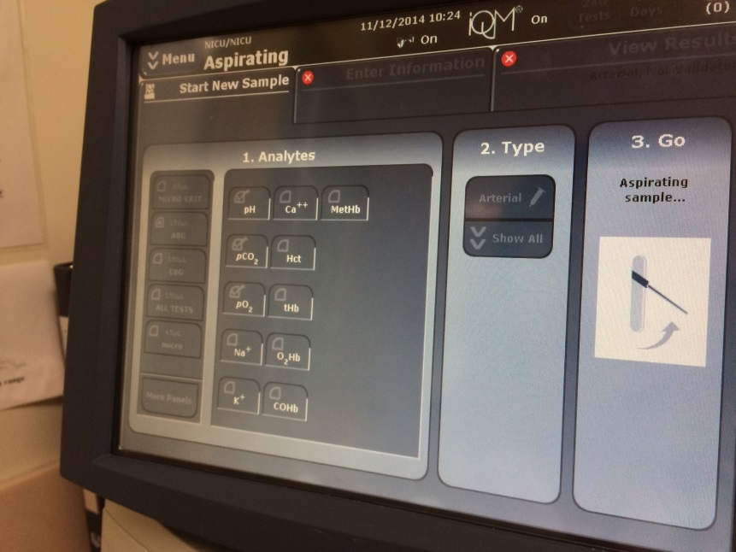
Patient Sampling
The GEM prompts, “Present Sample Now”. Press OK to begin aspiration.
NOTE: You must have the sample in place before pressing OK or the GEM will aspirate air and results will be erroneous.
The system will aspirate the sample and display a message “Aspirating sample”.
Immediately remove the sample when you hear the “beep-beep” and “Remove Sample Now” is displayed on screen.

Slide 34
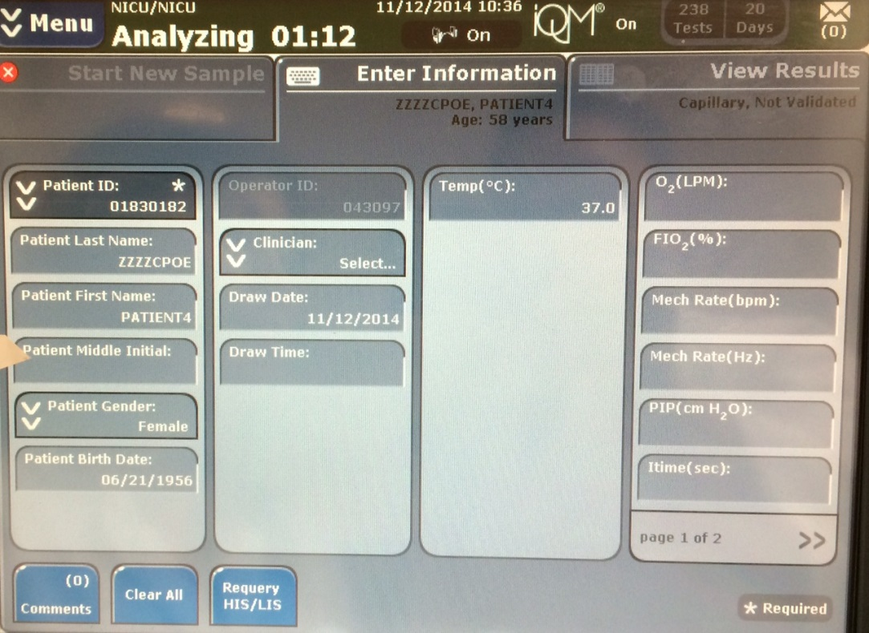
Patient Sampling
The system will perform analysis.
On the next screen SCAN in the Medical Record Number (MRN) BARCODE.
Patient’s information will appear. Verify the patient’s information. MRN, Patient’s Full Name and Date of Birth should match the label sticker on the specimen.
Enter MRN Here
Verify Patient Info

Slide 35
Patient Sampling
Comments can be entered on the Enter Information Screen. Comments may be free-text entries of selected from pre-defined entries.
Wait until results appear on the screen. If NO errors occur, results will automatically transmit to LCR (verify in LCR). If errors occur, results will not cross. Re-draw and retest or call POCT for help.
Only during downtime: attach the printed tape on the GEM 4000 POCT Results sheet . Place this results sheet in the patient’s medical chart.

Slide 36
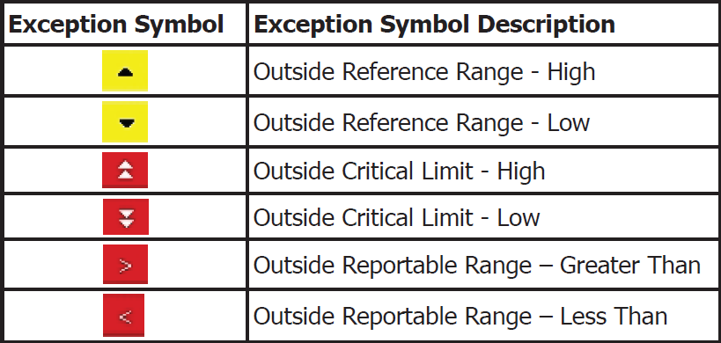
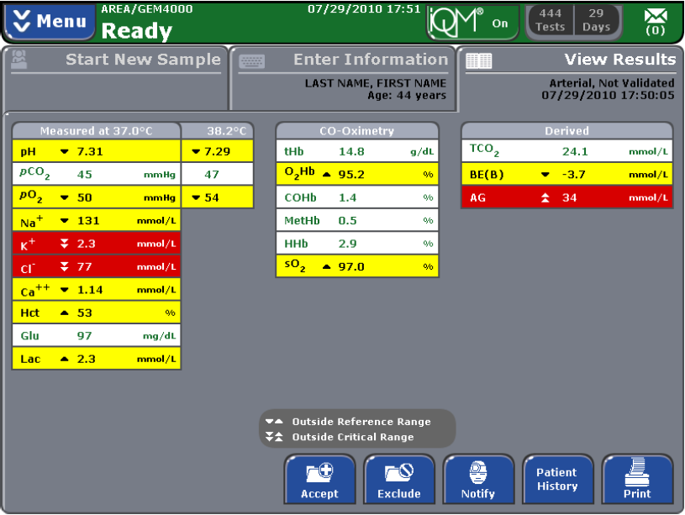
View Results
To view sample results, select the View Results tab.
Results outside Reference Range are displayed in black text on a yellow background.
Results outside the Critical Values Range are displayed in white text on a red background.
Results outside the Reportable Range are displayed.

Slide 37
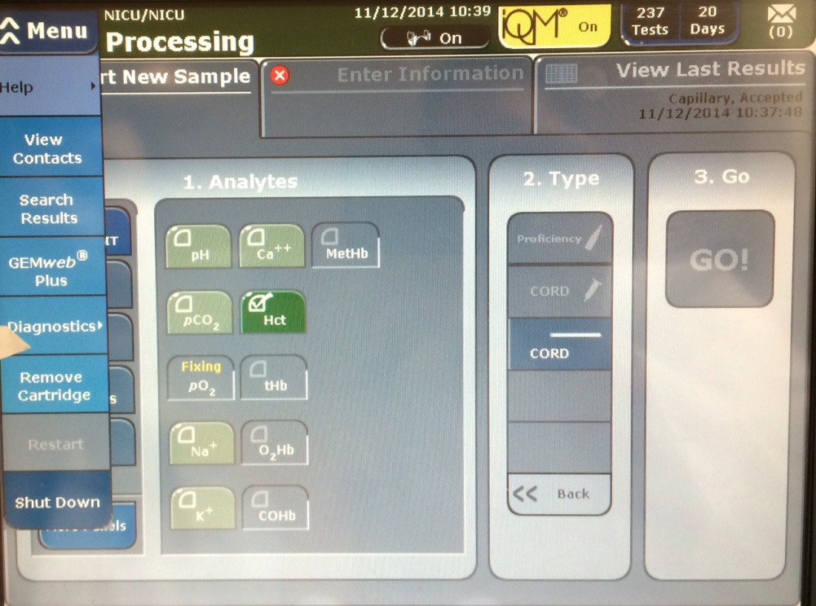
View Results
Search Patient Results
Select “Search Results” from the blue drop down Menu.
Scan your barcode to access this feature.

Slide 38
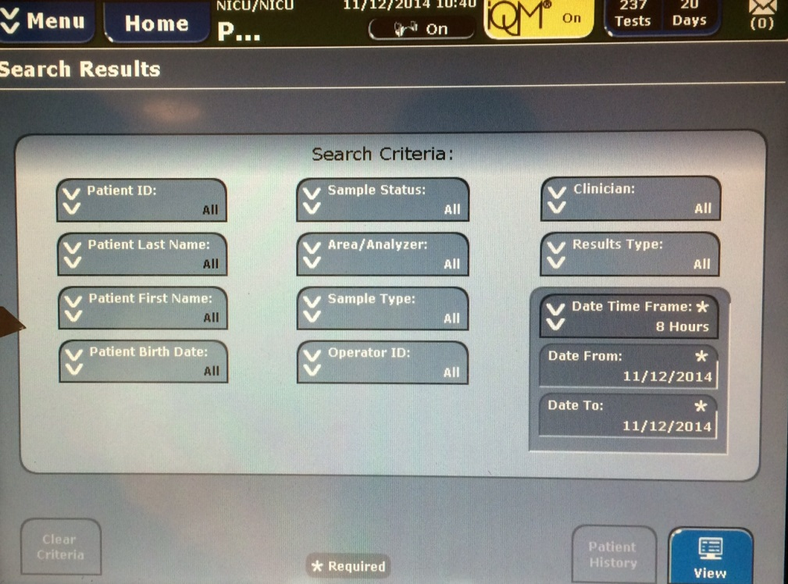
View Results
Search Patient Results
Enter search criteria in the Search Criteria area.
Enter Patient ID / MRN.
Date and time frame criteria are required for all searches.

Slide 39
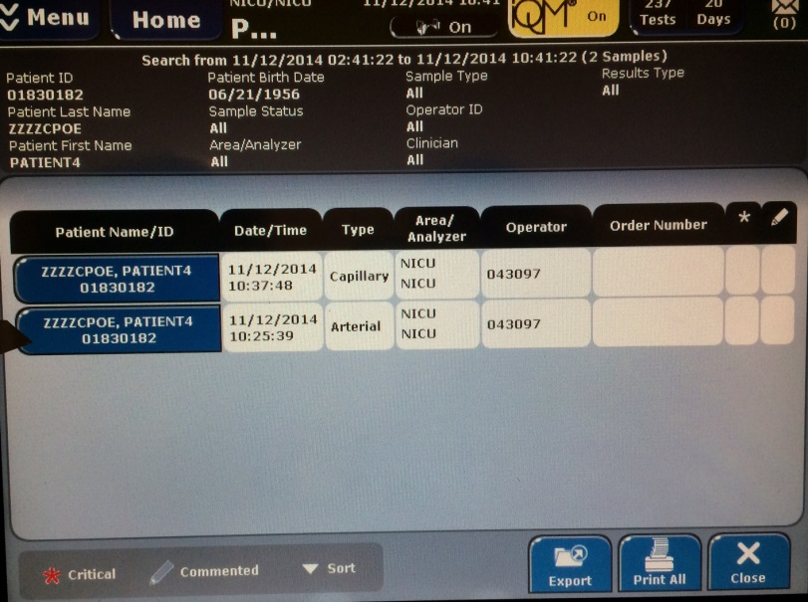
View Results
Search Patient Results
Press the View button to view results.

Slide 40
Cartridge Removal
The GEM Premier 4000 automatically notifies operators when it is time to remove the cartridge, i.e., when sample capacity or end of the cartridge’s 30-day on-board lifespan has been reached.
In each case the door will automatically open and display a message to the operator to “REMOVE CARTRIDGE”.
Cartridges may be removed prior to maximum onboard use-life or test capacity.
Examples are leakage or when the sensor is permanently disabled and its functionality cannot be recovered.
Notify a Unit Supervisor or Manager before changing the cartridge.

Slide 41
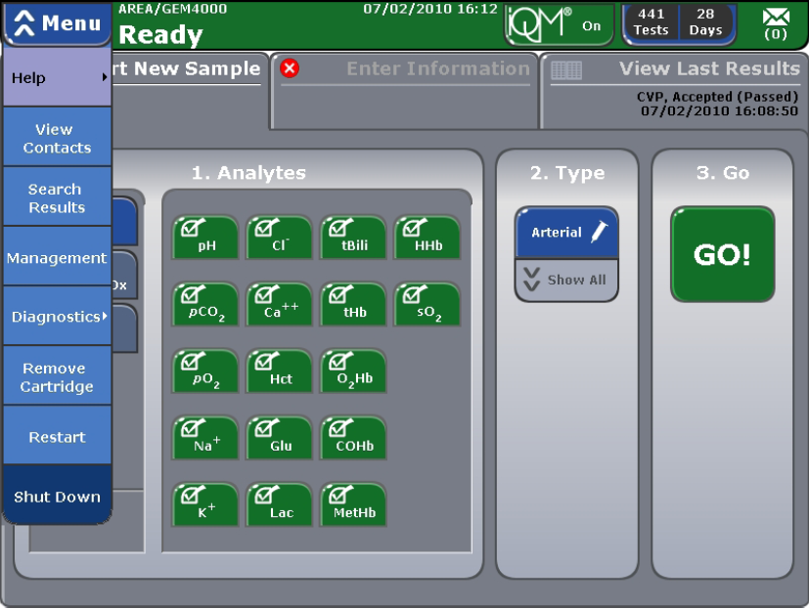
Cartridge Removal
Select the blue Menu button.
Press Remove cartridge from the drop down tab.
Enter your password.

Slide 42
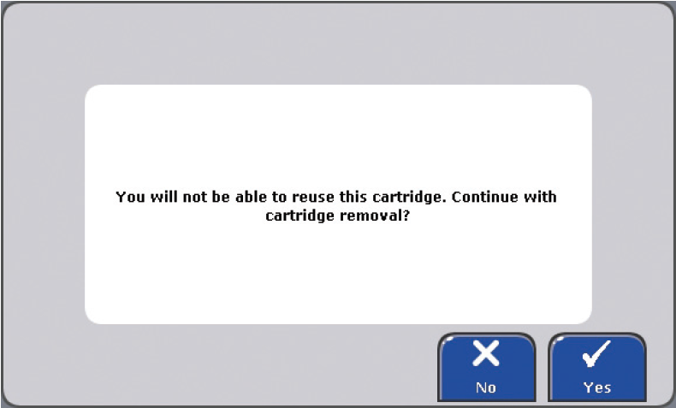
Cartridge Removal
The system will ask if you want to continue.
Press No to stop and return to the Start New Sample tab or press Yes to continue.
Once you press Yes, the door will click open slightly. Move the door to the left, grasp the cartridge, and pull it gently toward you. Dispose the cartridge in a biohazard container.

Slide 43
Shut Down Analyzer
Once the analyzer is shut down, power must be restored within 20 minutes or the cartridge will have to be removed and thrown away.
Press the blue Menu button in the upper left while on the Start New Sample tab. Select “Shut Down” from the pull down menu.
Press “Yes” to continue to shut down.

Slide 44
Cleaning the Analyzer
Dampen a soft cleaning cloth with water or mild cleaning solution.
Carefully wipe the face of the touch screen free of fingerprints and other smudges.
Remove any blood or dust for the outer surface of the instrument case using a clean, soft cloth moistened with 10% chlorine bleach.

Slide 45
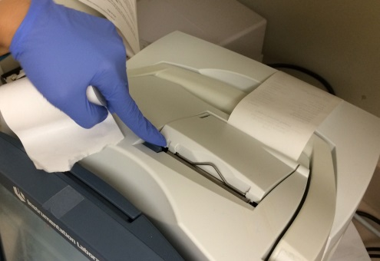
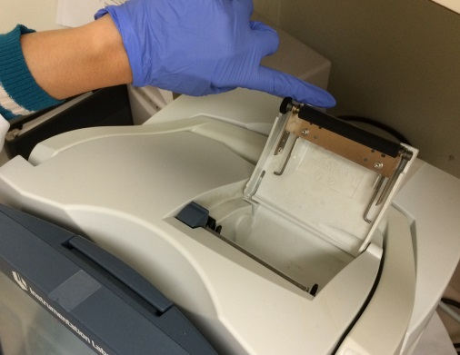
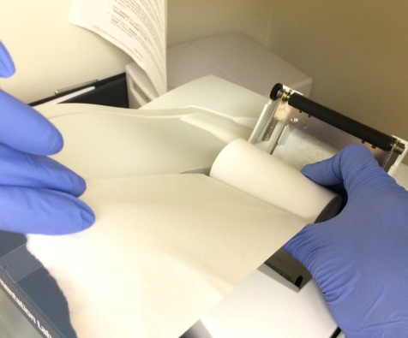
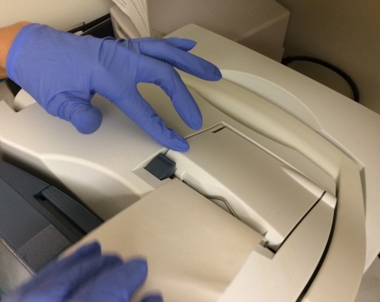
Installing Printer Paper
Press the tab at the top of the system to release the door.
Open the door .
Place the roll of paper in the compartment so the paper unfurls from the bottom.
Press the door firmly closed.

Slide 46
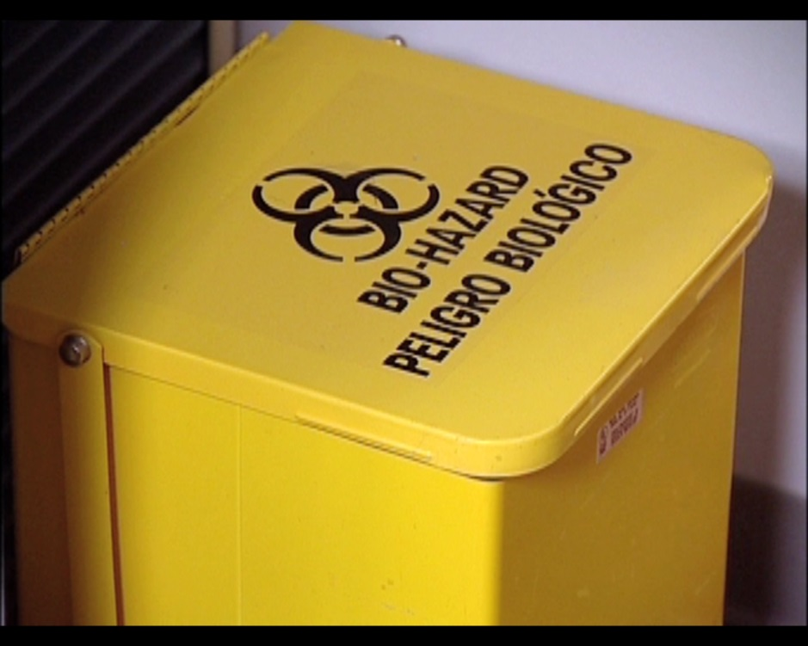
Ampule Breaker Disposal
Dispose of filled ampule breakers in a suitable biohazard container.

Slide 47
Analyzer Repair
Refer to the GEM 4000 Policy for troubleshooting guide.
If GEM Premier 4000 analyzer is broken or not working, contact Point of Care Testing Services first before attempting to send the analyzer to Instrumentation Laboratory.
Do not request a loaner without POCT Services approval.

Slide 48
Limitations and Interferences
Please refer to the Policy and Procedures for information about limitations and interferences for the GEM Premier 4000 Blood Gas Analyzer.

Slide 49
For Further Question or Information Contact POCT Services SFGH-POCT.org

