Slide 1
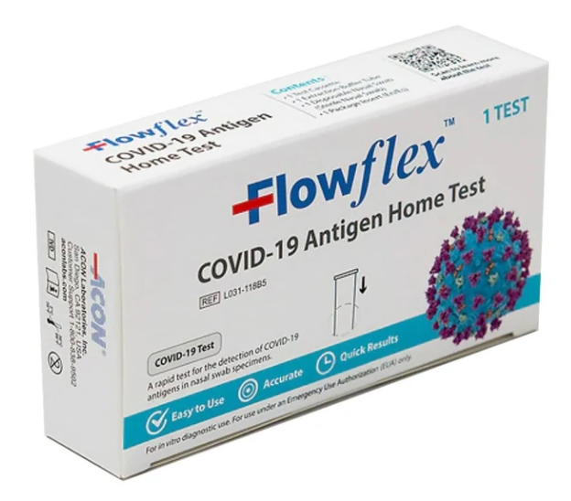
COVID-19 Antigen Home Test
Overview and Training
Emergency Use Authorization Granted by FDA
Created by Carol Taniguchi, PNP
01/13/2022

Slide 2
Intended Use: Key Points
COVID-19 Antigen Home Test
The Flowflex ™ COVID-19 Ag Home Test is intended for the qualitative detection of the nucleocapsid protein antigen from SARS-CoV-2 in anterior nasal swab specimens directly from individuals within 7 days of symptom onset or without symptoms or other epidemiological reasons to suspect COVID-19 infection.
SARS-CoV-2 nucleocapsid protein antigen is generally detectable in anterior nasal swabs during the acute phase of infection.
This test is authorized for non-prescription home use with self-collected anterior nasal swab specimens directly from individuals aged 14 years and older or with adult collected anterior nasal samples directly from individuals aged 2 years or older.
This test is also authorized as a waived test in clinical settings
Proprietary and confidential — do not distribute

Slide 3
COVID-19 Antigen Home Test
Emergency Use Authorization
The Flowflex ™ COVID-19 Ag Home Test is only for use under the Food and Drug Administration’s Emergency Use Authorization
What is Emergency Use Authorization (EUA)?
FDA emergency access mechanism
Health & Human Services declare when circumstances exist to justify use of diagnostics under EUA for the diagnosis of COVID-19
It is not full FDA clearance or approval and is temporary, until the declaration is terminated or revoked.
Proprietary and confidential — do not distribute

Slide 4
COVID-19 Antigen Home Test
Test Summary | Rapid lateral flow immunoassay for the qualitative detection of SARS-CoV-2
Testing Environment | Point of Care settings with a CLIA Certificate of Waiver, Compliance or Accreditation
Storage and Stability | Stored at temperatures between 36-86°F (2-30°C) DO NOT freeze Test should remain in sealed pouch until use Use before expiration date on sealed pouch
Specimen Type | Direct anterior nare swab
Time to Result | Results visually read at 15 minutes *Results should not be read after 30 minutes
Waste Disposal | All components should be discarded as Biohazard Waste
PPE for Specimen Collection & Handling | Refer to CDC Guidelines for collecting, handling and testing clinical specimens (link in Product Insert)
Proprietary and confidential — do not distribute

Slide 5
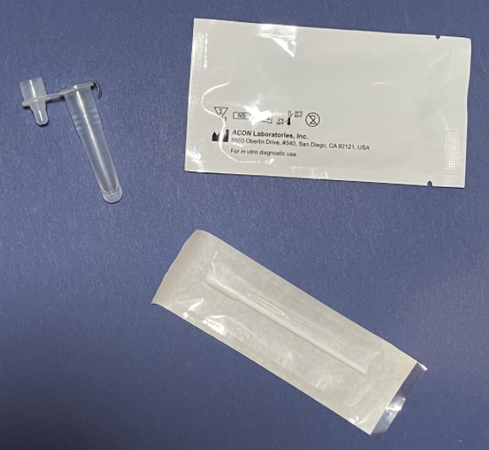
Reagent and Materials
COVID-19 Antigen Home Test
Materials Provided:
Test Cassette
Extraction Buffer Tubes
Disposable Nasal Swabs
Package Insert
Box with perforated circle to form a tube holder
Materials Required but not Provided:
Clock, timer or stopwatch
Proprietary and confidential — do not distribute

Slide 6
Quality Control
COVID-19 Antigen Home Test
External quality control is not run on Flowflex
Internal procedural controls are included in the test
A red line appearing in the control line region (C) is an internal procedural control. The appearance of the procedural control line indicates that proper volume of specimen has been added and capillary flow occurred.
If the procedural control line does not develop in 15 minutes, the test result is considered invalid, and retesting with a new cassette is recommended. Invalid tests are usually due to insufficient specimen volume or lack of proper technique
If the problem persists, call (800) 838-9502 for assistance.
Proprietary and confidential — do not distribute

Slide 7
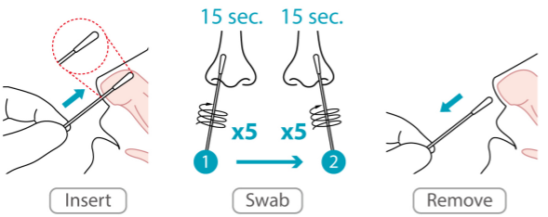
Nasal Swab Sample Collection
COVID-19 Antigen Home Test
Only the swab included in the Home Test kit may be used
Gently insert the entire absorbent tip of the swab head into 1 nostril (½ to ¾ of an inch). With children, the maximum depth of insertion into the nostril may be less than ¾ of an inch, and you may need to have a second person to hold the child’s head while swabbing. Note: A false negative result may occur if the nasal swab specimen is not properly collected.
Firmly rub the swab in a circular motion around the inside wall of the nostril 5 times. Take approximately 15 seconds to collect the specimen. Be sure to collect any nasal drainage that may be present onto the swab. Repeat this in the other nostril using the same swab.

Slide 8
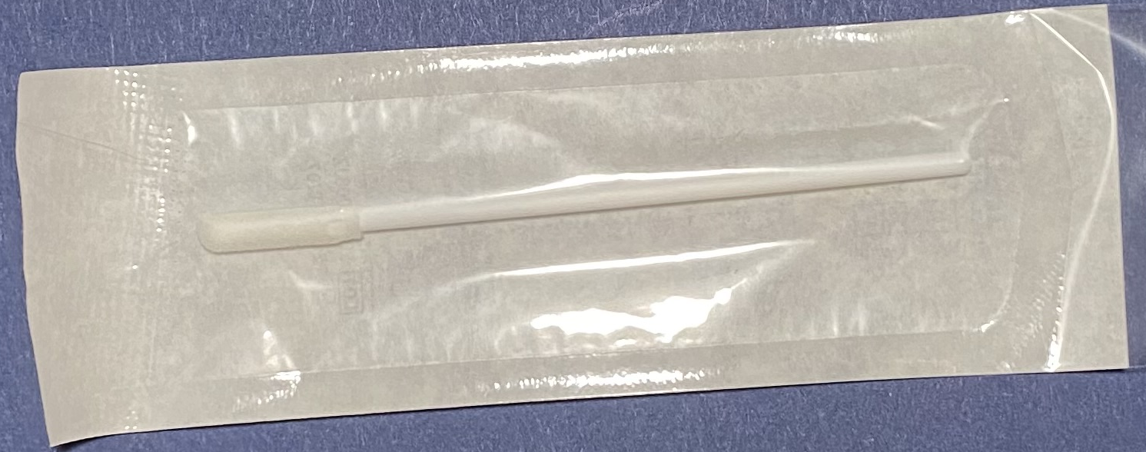
Specimen Transport & Storage
COVID-19 Antigen Home Test
Do not open the test pouch if you are not ready to test. Once open the test is only good for 1 hour
Do not contaminate the absorbant tip of swab by touching with fingers or lying on surface
Once nasal swab is collected place immediately into the buffer tube

Slide 9
COVID-19 Antigen Home Test
Test Procedures
Wash hands and find a clean flat surface to work
Confirm Flowflex ™ COVID-19 Ag Home Test is not past expiration date and open test box (keeping box intact to use a tube holder)
Punch out perforated circle on box and insert buffer tube
Peel foil off buffer tube
Open swab and obtain nasal sample
Place swab in buffer tube
Swirl the swab in the tube for a full 30 seconds (failure to do this for full 30 seconds may result in false result)
Then rotate swab 5 times while squeezing bottom of buffer tube (failure to rotate swab 5 full times may result in false result)
Remove swab while squeezing tube to extract maximum amount of liquid from swab
Discard tube and place dropper cap on tube, tightly
Invert tube over test sample well and drop 4 drops (failure to drop 4 full drop could result in false result)
Set timer for 15 minutes and let test sit uninterrupted
Read test after 15 minutes and no more than 30 minutes after drops placed

Slide 10
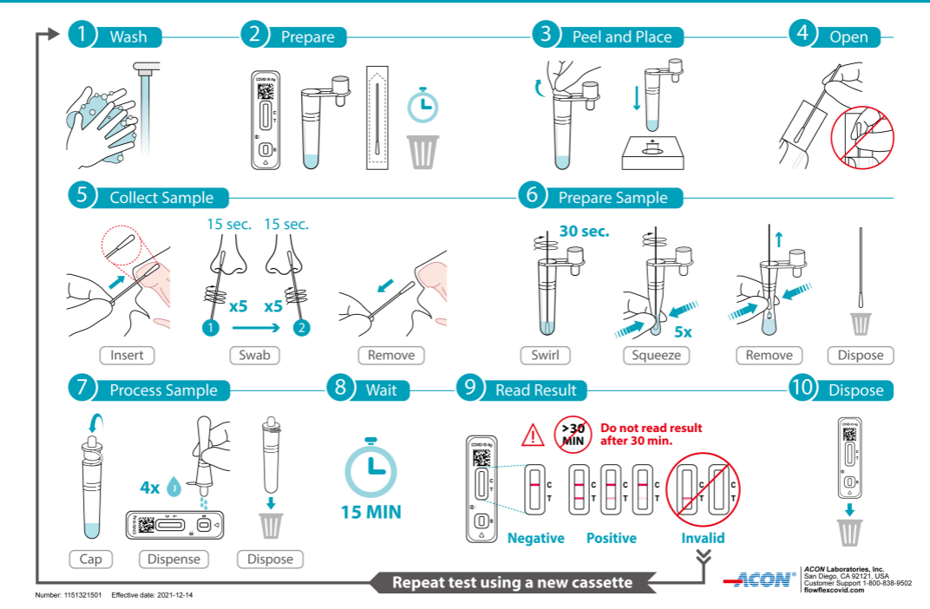
COVID
COVID-19 Antigen Home Test
Proprietary and confidential — do not distribute

Slide 11
COVID-19 Antigen Home Test
Test Procedures
https://youtu.be/9ShFIzJtaT8

Slide 12
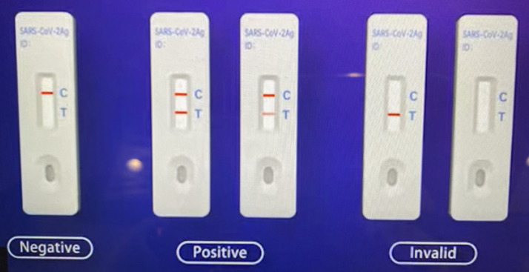
Result Interpretation
COVID-19 Antigen Home Test
NEGATIVE | POSITIVE | INVALID
Only one red control line appears in the control line region (C). No apparent red line appears in the test line region (T). This means that no SARS-CoV-2 antigen was detected | Two distinct red lines appear. One red line in the control line region (C) and the other red line in the test line region (T). This means that the presence of SARS-CoV-2 antigen | Control line fails to appear. Insufficient specimen volume or incorrect operation are the most likely reasons for control line failure. Review the procedure and repeat the test with a new test cassette.
Proprietary and confidential — do not distribute

Slide 13
Result Interpretation
COVID-19 Antigen Home Test
The intensity of the red color in the test line (T) may vary depending on the level of the SARS-CoV2 antigen present in the specimen. Therefore, any shade of red in the test line region (T) should be considered positive.
Proprietary and confidential — do not distribute

